Slide 1


Network Layer All about routing
SE3331-1 (2024 Fall)
IPADS, Shanghai Jiao Tong University
https://www.sjtu.edu.cn
Credits to Katrina LaCurts, MIT

Slide 2
Routing
How to generate the routing table?

Slide 3
Goal of A Routing Protocol
Allow each switch to know, for every node dst in the network, a route to dst
Allow each switch to know, for every node dst in the network, a minimum-cost route to dst
Build a routing table at each switch, such that routing_table[dst] contains a minimum-cost route to dst

Slide 4
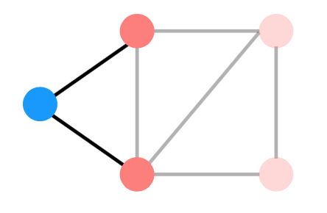
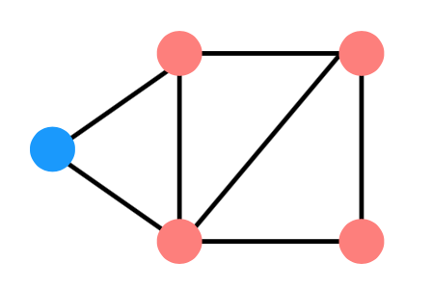
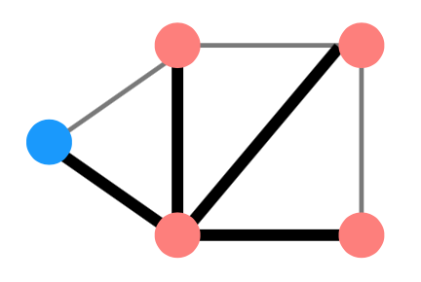
Distributed Routing: 3 Steps in General
Nodes learn about their neighbors via the HELLO protocol
Nodes learn about other reachable nodes via advertisements
Nodes determine the minimum-cost routes (of the routes they know about)

Slide 5
Two Types of Routing Protocol
Protocol 1: Link-state
A node's advertisements contain a list of its neighbors and its link costs to those nodes
Nodes advertise to everyone their costs to their neighbors
via flooding
Integrate using Dijkstra's shortest path algorithm
Protocol 2: Distance-vector
Nodes advertise to neighbors with their cost to all known nodes
Update routes via Bellman-Ford integration

Slide 6
link-state routing: disseminate full topology information so that nodes can run a shortest-path algorithm
link state
what’s in an advertisement
its link costs to each of its neighbors
who gets a node’s advertisement
effectively, every other node (via flooding)
B
3
C
7
1
5
A
2
D
4
1
3
F E
5
A’s advertisement: [(B,7),(D,2),(F,1)]

Slide 7
link-state routing: disseminate full topology information so that nodes can run a shortest-path algorithm
link state
what’s in an advertisement
its link costs to each of its neighbors
who gets a node’s advertisement
effectively, every other node (via flooding)
B
3
C
7
1
5
A
2
D
4
1
3
F E
5
A’s advertisement: [(B,7),(D,2),(F,1)]

Slide 8
link-state routing: disseminate full topology information so that nodes can run a shortest-path algorithm
link state
what’s in an advertisement
its link costs to each of its neighbors
who gets a node’s advertisement
effectively, every other node (via flooding)
B
3
C
7
1
5
A
2
D
4
1
3
F E
5
A’s advertisement: [(B,7),(D,2),(F,1)]

Slide 9
link-state routing: disseminate full topology information so that nodes can run a shortest-path algorithm
link state
what’s in an advertisement
its link costs to each of its neighbors
who gets a node’s advertisement
effectively, every other node (via flooding)
B
3
C
7
1
5
A
2
D
4
1
3
F E
5
A’s advertisement: [(B,7),(D,2),(F,1)]

Slide 10
link-state routing: disseminate full topology information so that nodes can run a shortest-path algorithm
link state
what’s in an advertisement
its link costs to each of its neighbors
who gets a node’s advertisement
effectively, every other node (via flooding)
B
3
C
7
1
5
A
2
D
4
1
3
F E
5
A’s advertisement: [(B,7),(D,2),(F,1)]

Slide 11
link-state routing: disseminate full topology information so that nodes can run a shortest-path algorithm
link state
what’s in an advertisement
its link costs to each of its neighbors
who gets a node’s advertisement
effectively, every other node (via flooding)
B
3
C
7
1
5
A
2
D
4
1
3
F E
5
A’s advertisement: [(B,7),(D,2),(F,1)]

Slide 12
link-state routing: disseminate full topology information so that nodes can run a shortest-path algorithm
link state
B
3
C
what’s in an advertisement
its link costs to each of its neighbors
7
1
5
who gets a node’s advertisement
A
2
D
effectively, every other node (via flooding)
4
1
3
F E
5
A’s advertisement: [(B,7),(D,2),(F,1)]
nodes keep track of which advertisements they’ve forwarded so that they don’t re-forward them
they can also be a bit smarter about flooding, and not forward an advertisement back to the node that sent it

Slide 13
link-state routing: disseminate full topology information so that nodes can run a shortest-path algorithm
link state
B
3
C
what’s in an advertisement
its link costs to each of its neighbors
7
1
5
who gets a node’s advertisement
A
2
D
effectively, every other node (via flooding)
4
1
3
F
5
E
nodes integrate advertisements by running Dijkstra’s Algorithm

Slide 14
link-state routing: disseminate full topology information so that nodes can run a shortest-path algorithm
link state
B
3
C
what’s in an advertisement
its link costs to each of its neighbors
7
1
5
who gets a node’s advertisement
A
2
D
effectively, every other node (via flooding)
4
1
3
F
5
E
A’s routing table
dst | route | cost
B | | | A-B | | | 7
C | | | ? | | | ∞
D | | | A-D | | | 2
E | | | ? | | | ∞
F | | | A-F | | | 1

Slide 15
Link-state Routing
Keep track of W, the set of nodes haven't processed yet
Initially, W is all nodes in the network
Keep track of the current costs and routes to all of the nodes. Initially:
routing_table[self] = Self; routing_table[anyone else] = ?
cost_table[self] = 0; cost_table[anyone else] = infinity
While W is not empty:
1. u = the node in W we have the minimum cost to so far
2. Remove u from W
3. For every neighbor v of u: d = cost_table[u] + cost(u, v) if d < cost_table[v] cost_table[v] = d routing_table[v] = routing_table[u]

Slide 16
link-state routing: disseminate full topology information so that nodes can run a shortest-path algorithm
link state
B
3
C
what’s in an advertisement
its link costs to each of its neighbors
7
1
5
who gets a node’s advertisement
A
2
D
effectively, every other node (via flooding)
4
1
3
F
5
E
A’s routing table
dst | route | cost
B | | | A-B | | | 7
C | | | ? | | | ∞
D | | | A-D | | | 2
E | | | ? | | | ∞
F | | | A-F | | | 1

Slide 17
link-state routing: disseminate full topology information so that nodes can run a shortest-path algorithm
link state
B
3
C
what’s in an advertisement
its link costs to each of its neighbors
7
1
5
who gets a node’s advertisement
A
2
D
effectively, every other node (via flooding)
4
1
3
F
5
E
A’s routing table
dst | route | cost
B | | | A-B | | | 7
C | | | ? | | | ∞
D | | | A-D | | | 2
E | | | ? | | | ∞
F | | | A-F | | | 1

Slide 18
link-state routing: disseminate full topology information so that nodes can run a shortest-path algorithm
link state
B
3
C
what’s in an advertisement
its link costs to each of its neighbors
7
1
5
who gets a node’s advertisement
A
2
D
effectively, every other node (via flooding)
4
1
3
F
5
E
A’s routing table
dst | route | cost
B | | | A-B | | | 7
C | | | ? | | | ∞
D | | | A-D | | | 2
E | | | ? | | | ∞
F | | | A-F | | | 1

Slide 19
link-state routing: disseminate full topology information so that nodes can run a shortest-path algorithm
link state
B
3
C
what’s in an advertisement
its link costs to each of its neighbors
7
1
5
who gets a node’s advertisement
A
2
D
effectively, every other node (via flooding)
4
1
3
F
5
E
A’s routing table
dst | route | cost
B | | | A-B | | | 7
C | | | ? | | | ∞
D | | | A-D | | | 2
E | | | ? | | | ∞
F | | | A-F | | | 1
F does not provide A with a better route to D

Slide 20
link-state routing: disseminate full topology information so that nodes can run a shortest-path algorithm
link state
B
3
C
what’s in an advertisement
its link costs to each of its neighbors
7
1
5
who gets a node’s advertisement
A
2
D
effectively, every other node (via flooding)
4
1
3
F
5
E
A’s routing table
dst | route | cost
B | | | A-B | | | 7
C | | | ? | | | ∞
D | | | A-D | | | 2
E | | | ? | | | ∞
F | | | A-F | | | 1

Slide 21
link-state routing: disseminate full topology information so that nodes can run a shortest-path algorithm
link state
B
3
C
what’s in an advertisement
its link costs to each of its neighbors
7
1
5
who gets a node’s advertisement
A
2
D
effectively, every other node (via flooding)
4
1
3
F
5
E
A’s routing table
dst | route | cost
B | | | A-B | | | 7
C | | | ? | | | ∞
D | | | A-D | | | 2
E | | | A-F | | | 6
F | | | A-F | | | 1
= the cost from A to F + the cost from F to E

Slide 22
link-state routing: disseminate full topology information so that nodes can run a shortest-path algorithm
link state
B
3
C
what’s in an advertisement
its link costs to each of its neighbors
7
1
5
who gets a node’s advertisement
A
2
D
effectively, every other node (via flooding)
4
1
3
F
5
E
A’s routing table
dst | route | cost
B | | | A-B | | | 7
C | | | ? | | | ∞
D | | | A-D | | | 2
E | | | A-F | | | 6
F | | | A-F | | | 1

Slide 23
link-state routing: disseminate full topology information so that nodes can run a shortest-path algorithm
link state
B
3
C
what’s in an advertisement
its link costs to each of its neighbors
7
1
5
who gets a node’s advertisement
A
2
D
effectively, every other node (via flooding)
4
1
3
F
5
E
A’s routing table
dst | route | cost
B | | | A-B | | | 7
C | | | ? | | | ∞
D | | | A-D | | | 2
E | | | A-F | | | 6
F | | | A-F | | | 1

Slide 24
link-state routing: disseminate full topology information so that nodes can run a shortest-path algorithm
link state
B
3
C
what’s in an advertisement
its link costs to each of its neighbors
7
1
5
who gets a node’s advertisement
A
2
D
effectively, every other node (via flooding)
4
1
3
F
5
E
A’s routing table
dst | route | cost
B | | | A-B | | | 7
C | | | ? | | | ∞
D | | | A-D | | | 2
E | | | A-F | | | 6
F | | | A-F | | | 1

Slide 25
link-state routing: disseminate full topology information so that nodes can run a shortest-path algorithm
link state
B
3
C
what’s in an advertisement
its link costs to each of its neighbors
7
1
5
who gets a node’s advertisement
A
2
D
effectively, every other node (via flooding)
4
1
3
F
5
E
A’s routing table
dst | route | cost
B | | | A-B | | | 3
C | | | ? | | | ∞
D | | | A-D | | | 2
E | | | A-F | | | 6
F | | | A-F | | | 1

Slide 26
link-state routing: disseminate full topology information so that nodes can run a shortest-path algorithm
link state
B
3
C
what’s in an advertisement
its link costs to each of its neighbors
7
1
5
who gets a node’s advertisement
A
2
D
effectively, every other node (via flooding)
4
1
3
F
5
E
A’s routing table
dst | route | cost
B | | | A-B | | | 3
C | | | ? | | | ∞
D | | | A-D | | | 2
E | | | A-F | | | 6
F | | | A-F | | | 1

Slide 27
link-state routing: disseminate full topology information so that nodes can run a shortest-path algorithm
link state
B
3
C
what’s in an advertisement
its link costs to each of its neighbors
7
1
5
who gets a node’s advertisement
A
2
D
effectively, every other node (via flooding)
4
1
3
F
5
E
A’s routing table
dst | route | cost
B | | | A-B | | | 3
C | | | A-D | | | 7
D | | | A-D | | | 2
E | | | A-F | | | 6
F | | | A-F | | | 1

Slide 28
link-state routing: disseminate full topology information so that nodes can run a shortest-path algorithm
link state
B
3
C
what’s in an advertisement
its link costs to each of its neighbors
7
1
5
who gets a node’s advertisement
A
2
D
effectively, every other node (via flooding)
4
1
3
F
5
E
A’s routing table
dst | route | cost
B | | | A-B | | | 3
C | | | A-D | | | 7
D | | | A-D | | | 2
E | | | A-F | | | 6
F | | | A-F | | | 1

Slide 29
link-state routing: disseminate full topology information so that nodes can run a shortest-path algorithm
link state
B
3
C
what’s in an advertisement
its link costs to each of its neighbors
7
1
5
who gets a node’s advertisement
A
2
D
effectively, every other node (via flooding)
4
1
3
F
5
E
A’s routing table
dst | route | cost
B | | | A-B | | | 3
C | | | A-D | | | 7
D | | | A-D | | | 2
E | | | A-D | | | 5
F | | | A-F | | | 1

Slide 30
link-state routing: disseminate full topology information so that nodes can run a shortest-path algorithm
link state
what’s in an advertisement
its link costs to each of its neighbors
who gets a node’s advertisement
effectively, every other node (via flooding)
B
3
C
7
1
5
A
2
D
4
1
3
F
5
E
A’s routing table
dst | route | cost
B | | | A-B | | | 3
C | | | A-D | | | 7
D | | | A-D | | | 2
E | | | A-D | | | 5
F | | | A-F | | | 1
we don’t need to “visit” F; we already know the shortest path to it

Slide 31
link-state routing: disseminate full topology information so that nodes can run a shortest-path algorithm
link state
B
3
C
what’s in an advertisement
its link costs to each of its neighbors
7
1
5
who gets a node’s advertisement
A
2
D
effectively, every other node (via flooding)
4
1
3
F
5
E
A’s routing table
dst | route | cost
B | | | A-B | | | 3
C | | | A-D | | | 7
D | | | A-D | | | 2
E | | | A-D | | | 5
F | | | A-F | | | 1

Slide 32
link-state routing: disseminate full topology information so that nodes can run a shortest-path algorithm
link state
B
3
C
what’s in an advertisement
its link costs to each of its neighbors
7
1
5
who gets a node’s advertisement
A
2
D
effectively, every other node (via flooding)
4
1
3
F
5
E
A’s routing table
dst | route | cost
B | | | A-B | | | 3
C | | | A-D | | | 7
D | | | A-D | | | 2
E | | | A-D | | | 5
F | | | A-F | | | 1

Slide 33
link-state routing: disseminate full topology information so that nodes can run a shortest-path algorithm
link state
what’s in an advertisement
its link costs to each of its neighbors
who gets a node’s advertisement
effectively, every other node (via flooding)
B
3
C
7
1
5
A
2
D
4
1
3
F
5
E
A’s routing table
dst | route | cost
B | | | A-B | | | 3
C | | | A-D | | | 6
D | | | A-D | | | 2
E | | | A-D | | | 5
F | | | A-F | | | 1
notice that A’s route doesn’t change, but the cost needs to update
(and the actual path of the packets from A to C has changed)

Slide 34
link-state routing: disseminate full topology information so that nodes can run a shortest-path algorithm
link state
B
3
C
what’s in an advertisement
its link costs to each of its neighbors
7
1
5
who gets a node’s advertisement
A
2
D
effectively, every other node (via flooding)
4
1
3
F
5
E
A’s routing table
dst | route | cost
B | | | A-B | | | 3
C | | | A-D | | | 6
D | | | A-D | | | 2
E | | | A-D | | | 5
F | | | A-F | | | 1

Slide 35
link-state routing: disseminate full topology information so that nodes can run a shortest-path algorithm
link state
B
3
C
what’s in an advertisement
its link costs to each of its neighbors
7
1
5
who gets a node’s advertisement
A
2
D
effectively, every other node (via flooding)
4
1
3
F
5
E
A’s routing table
dst | route | cost
B | | | A-B | | | 3
C | | | A-D | | | 6
D | | | A-D | | | 2
E | | | A-D | | | 5
F | | | A-F | | | 1

Slide 36
link-state routing: disseminate full topology information so that nodes can run a shortest-path algorithm
link state
B
3
C
what’s in an advertisement
its link costs to each of its neighbors
7
1
5
who gets a node’s advertisement
A
2
D
effectively, every other node (via flooding)
4
1
3
F
5
E
A’s routing table
dst | route | cost
B | | | A-B | | | 3
C | | | A-D | | | 6
D | | | A-D | | | 2
E | | | A-D | | | 5
F | | | A-F | | | 1

Slide 37
link-state routing: disseminate full topology information so that nodes can run a shortest-path algorithm
link state
B
3
C
what’s in an advertisement
its link costs to each of its neighbors
7
1
5
who gets a node’s advertisement
A
2
D
effectively, every other node (via flooding)
4
1
3
what happens when things fail?
flooding makes link- state routing very resilient to failure
F
5
E
what limits scale?
the overhead of flooding

Slide 38
Distance-vector Routing
In link-state, nodes calculate full shortest paths. But actually they only need the route (first-hop) to a destination
Advertisement format: Each node's advertisement is a list of all the nodes it knows about, and its current costs to those nodes
Initially, this advertisement is just [(self, 0)].
Nodes who receive an advertisement: Node X's advertisement will be received only by its neighbors
Integrate step: When node X receives an advertisement from its neighbor Y, this advertisement will be a list of [(dst, cost)] pairs. Each cost represents Y's cost to dst

Slide 39
Distance-vector Routing
For each (dst, cost) in the advertisement, X needs to check for two things:
If X is already using Y to get to dst, update the cost information (remember, costs can change!)
If X is not using Y to get to dst, see if Y could provide a better path; if so, update the routing and cost information

Slide 40
distance-vector routing: disseminate information about the current costs to each node, rather than the actual topology
link state distance vector
what’s in an advertisement
B
3
C
its link costs to each of its neighbors
its current costs to
every node it’s aware of
7
1
5
who gets a node’s advertisement
A
2
D
effectively, every other node (via flooding)
only its neighbors
4
1
3
what happens when things fail?
flooding makes link- state routing very resilient to failure
F E
5
A’s first advertisement: [(B,7),(D,2),(F,1)]
A could also include (A,0) here
A’s routing table
what limits scale?
the overhead of flooding
dst | route | cost
A’s advertisement reflects its routing table, and right now, A only knows about its neighbors
B | A-B | 7 D | A-D | 2
F
|
A-F
|
1

Slide 41
distance-vector routing: disseminate information about the current costs to each node, rather than the actual topology
link state distance vector
what’s in an advertisement
B
3
C
its link costs to each of its neighbors
its current costs to
every node it’s aware of
7
1
5
who gets a node’s advertisement
A
2
D
effectively, every other node (via flooding)
only its neighbors
4
1
3
what happens when things fail?
flooding makes link- state routing very resilient to failure
F E
5
A’s first advertisement: [(B,7),(D,2),(F,1)]
A could also include (A,0) here
A’s routing table
what limits scale?
the overhead of flooding
dst | route | cost
A’s advertisement reflects its routing table, and right now, A only knows about its neighbors
B | A-B | 7 D | A-D | 2
F
|
A-F
|
1

Slide 42
distance-vector routing: disseminate information about the current costs to each node, rather than the actual topology
link state distance vector
what’s in an advertisement
B
3
C
its link costs to each of its neighbors
its current costs to
every node it’s aware of
7
1
5
who gets a node’s advertisement
A
2
D
effectively, every other node (via flooding)
only its neighbors
4
1
3
what happens when things fail?
flooding makes link- state routing very resilient to failure
F E
5
A’s first advertisement: [(B,7),(D,2),(F,1)]
what limits scale?
A’s routing table
dst | route | cost
the overhead of flooding
A’s neighbors do not forward A’s advertisements; they do send advertisements of their own to A
B | A-B | 7 D | A-D | 2
F
|
A-F
|
1

Slide 43
distance-vector routing: disseminate information about the current costs to each node, rather than the actual topology
link state distance vector
what’s in an advertisement
B
3
C
its link costs to each of its neighbors
its current costs to
every node it’s aware of
7
1
5
who gets a node’s advertisement
A
2
D
effectively, every other node (via flooding)
only its neighbors
4
1
3
what happens when things fail?
flooding makes link- state routing very resilient to failure
F E
5
A’s first advertisement: [(B,7),(D,2),(F,1)]
what limits scale?
A’s routing table
dst | route | cost
the overhead of flooding
A’s neighbors do not forward A’s advertisements; they do send advertisements of their own to A
B | A-B | 7 D | A-D | 2
F
|
A-F
|
1

Slide 44
distance-vector routing: disseminate information about the current costs to each node, rather than the actual topology
link state distance vector
what’s in an advertisement
B
3
C
its link costs to each of its neighbors
its current costs to
every node it’s aware of
7
1
5
who gets a node’s advertisement
A
2
D
effectively, every other node (via flooding)
only its neighbors
4
1
3
what happens when things fail?
flooding makes link- state routing very resilient to failure
F E
5
A’s first advertisement: [(B,7),(D,2),(F,1)]
what limits scale?
A’s routing table
dst | route | cost
the overhead of flooding
A’s neighbors do not forward A’s advertisements; they do send advertisements of their own to A
B | A-B | 7 D | A-D | 2
F
|
A-F
|
1

Slide 45
distance-vector routing: disseminate information about the current costs to each node, rather than the actual topology
link state distance vector
what’s in an advertisement
B
3
C
its link costs to each of its neighbors
its current costs to
every node it’s aware of
7
1
5
who gets a node’s advertisement
A
2
D
effectively, every other node (via flooding)
only its neighbors
4
1
3
what happens when things fail?
flooding makes link- state routing very resilient to failure
F E
5
A’s first advertisement: [(B,7),(D,2),(F,1)]
what limits scale?
A’s routing table
dst | route | cost
the overhead of flooding
A’s neighbors do not forward A’s advertisements; they do send advertisements of their own to A
B | A-B | 7 D | A-D | 2
F
|
A-F
|
1

Slide 46
distance-vector routing: disseminate information about the current costs to each node, rather than the actual topology
link state distance vector
what’s in an advertisement
B
3
C
its link costs to each of its neighbors
its current costs to
every node it’s aware of
7
1
5
who gets a node’s advertisement
A
2
D
effectively, every other node (via flooding)
only its neighbors
4
1
3
what happens when things fail?
flooding makes link- state routing very resilient to failure
F
5
E
what limits scale?
A’s routing table
dst | route | cost
B’s | first | adv: | [(A,7), | (C,3), | (D,1)]
D’s | first | adv: | [(B,1), | (C,5), | (E,3), | (F,4)(A,2)]
F’s | first | adv: | [(A,1), | (D,4), | (E,5)]
the overhead of flooding
B | A-B | 7 D | A-D | 2
F
|
A-F
|
1
A receives advertisements
from B, D, and F

Slide 47
distance-vector routing: disseminate information about the current costs to each node, rather than the actual topology
link state distance vector
what’s in an advertisement
B
3
C
its link costs to each of its neighbors
its current costs to
every node it’s aware of
7
1
5
who gets a node’s advertisement
A
2
D
effectively, every other node (via flooding)
only its neighbors
4
1
3
what happens when things fail?
flooding makes link- state routing very resilient to failure
F
5
E
what limits scale?
A’s routing table
dst | route | cost
B’s | first | adv: | [(A,7), | (C,3), | (D,1)]
the overhead of flooding
B | A-B | 7 D | A-D | 2
F
|
A-F
|
1

Slide 48
distance-vector routing: disseminate information about the current costs to each node, rather than the actual topology
link state distance vector
what’s in an advertisement
B
3
C
its link costs to each of its neighbors
its current costs to
every node it’s aware of
7
1
5
who gets a node’s advertisement
A
2
D
effectively, every other node (via flooding)
only its neighbors
4
1
3
what happens when things fail?
flooding makes link- state routing very resilient to failure
F
5
E
what limits scale?
A’s routing table
dst | route | cost
B’s | first | adv: | [(A,7), | (C,3), | (D,1)]
the overhead of flooding
B | A-B | 7 C | A-B | 10
D | A-D | 2
A's cost to B + B's cost to C
F
|
A-F
|
1

Slide 49
distance-vector routing: disseminate information about the current costs to each node, rather than the actual topology
link state distance vector
what’s in an advertisement
B
3
C
its link costs to each of its neighbors
its current costs to
every node it’s aware of
7
1
5
who gets a node’s advertisement
A
2
D
effectively, every other node (via flooding)
only its neighbors
4
1
3
what happens when things fail?
flooding makes link- state routing very resilient to failure
F
5
E
what limits scale?
A’s routing table
dst | route | cost
B’s | first | adv: | [(A,7), | (C,3), | (D,1)]
D’s | first | adv: | [(B,1), | (C,5), | (E,3), | (F,4)(A,2)]
F’s | first | adv: | [(A,1), | (D,4), | (E,5)]
the overhead of flooding
B | A-B | 7 C | A-B | 10
D | A-D | 2
F
|
A-F
|
1

Slide 50
distance-vector routing: disseminate information about the current costs to each node, rather than the actual topology
link state distance vector
what’s in an advertisement
B
3
C
its link costs to each of its neighbors
its current costs to
every node it’s aware of
7
1
5
who gets a node’s advertisement
A
2
D
effectively, every other node (via flooding)
only its neighbors
4
1
3
what happens when things fail?
flooding makes link- state routing very resilient to failure
F
5
E
what limits scale?
A’s routing table
dst | route | cost
D’s | first | adv: | [(B,1), | (C,5), | (E,3), | (F,4)(A,2)]
the overhead of flooding
B | A-D | 3 C | A-D | 7
D | A-D | 2
E | A-D | 5
F
|
A-F
|
1

Slide 51
distance-vector routing: disseminate information about the current costs to each node, rather than the actual topology
link state distance vector
what’s in an advertisement
B
3
C
its link costs to each of its neighbors
its current costs to
every node it’s aware of
7
1
5
who gets a node’s advertisement
A
2
D
effectively, every other node (via flooding)
only its neighbors
4
1
3
what happens when things fail?
flooding makes link- state routing very resilient to failure
F
5
E
what limits scale?
A’s routing table
dst | route | cost
B’s | first | adv: | [(A,7), | (C,3), | (D,1)]
D’s | first | adv: | [(B,1), | (C,5), | (E,3), | (F,4)(A,2)]
F’s | first | adv: | [(A,1), | (D,4), | (E,5)]
the overhead of flooding
B | A-D | 3 C | A-D | 7
D | A-D | 2
E | A-D | 5
F
|
A-F
|
1

Slide 52
distance-vector routing: disseminate information about the current costs to each node, rather than the actual topology
link state distance vector
what’s in an advertisement
B
3
C
its link costs to each of its neighbors
its current costs to
every node it’s aware of
7
1
5
who gets a node’s advertisement
A
2
D
effectively, every other node (via flooding)
only its neighbors
4
1
3
what happens when things fail?
flooding makes link- state routing very resilient to failure
F
5
E
what limits scale?
A’s routing table
dst | route | cost
the overhead of flooding
F’s first adv: [(A,1), (D,4), (E,5)]
B | A-D | 3 C | A-D | 7
D | A-D | 2
E | A-D | 5
F
|
A-F
|
1

Slide 53
distance-vector routing: disseminate information about the current costs to each node, rather than the actual topology
link state distance vector
what’s in an advertisement
B
3
C
its link costs to each of its neighbors
its current costs to
every node it’s aware of
7
1
5
who gets a node’s advertisement
A
2
D
effectively, every other node (via flooding)
only its neighbors
4
1
3
what happens when things fail?
flooding makes link- state routing very resilient to failure
F
5
E
this is A’s routing table after one round of advertisements; note that it does not have knowledge of the min-cost route to C yet
what limits scale?
A’s routing table
dst | route | cost
the overhead of flooding
B | A-D | 3 C | A-D | 7
D | A-D | 2
E | A-D | 5
F
|
A-F
|
1

Slide 54
distance-vector routing: disseminate information about the current costs to each node, rather than the actual topology
link state distance vector
what’s in an advertisement
B
3
C
its link costs to each of its neighbors
its current costs to
every node it’s aware of
7
1
5
who gets a node’s advertisement
A
2
D
effectively, every other node (via flooding)
only its neighbors
4
1
3
what happens when things fail?
flooding makes link- state routing very resilient to failure
F
5
E
what limits scale?
A’s routing table
dst | route | cost
A’s second adv:
[(B,3), (C,7), (D,2), (E,5), (F,1)]
the overhead of flooding
B | A-D | 3 C | A-D | 7
D | A-D | 2
E | A-D | 5
F
|
A-F
|
1

Slide 55
distance-vector routing: disseminate information about the current costs to each node, rather than the actual topology
link state distance vector
what’s in an advertisement
B
3
C
its link costs to each of its neighbors
its current costs to
every node it’s aware of
7
1
5
who gets a node’s advertisement
A
2
D
effectively, every other node (via flooding)
only its neighbors
4
1
3
what happens when things fail?
flooding makes link- state routing very resilient to failure
F
5
E
what limits scale?
A’s routing table
dst | route | cost
A’s second adv:
[(B,3), (C,7), (D,2), (E,5), (F,1)]
the overhead of flooding
B | A-D | 3 C | A-D | 7
D | A-D | 2
E | A-D | 5
A will learn about the correct min-cost path to C in the next round of advertisements; try that out for yourself!
F
|
A-F
|
1

Slide 56
distance-vector routing: disseminate information about the current costs to each node, rather than the actual topology
link state distance vector
what’s in an advertisement
B
3
C
its link costs to each of its neighbors
its current costs to
every node it’s aware of
7
1
5
who gets a node’s advertisement
A
2
D
effectively, every other node (via flooding)
only its neighbors
4
1
3
what happens when things fail?
flooding makes link- state routing very resilient to failure
what happens when things fail?
failures can be complicated because of timing
F
5
E
what limits scale?
the overhead of flooding
failure handling

Slide 57
Problem of INFINITY
When a node A has no route to destination B, it will advertise a cost of INFINITY to B
A cost of INFINITY B is interpreted as there being no route to B
So INFINITY must be larger than the longest path in the network
But because the order in which advertisements are sent matters, sometimes nodes can incorrectly think there's a route when there isn't one
This can last for up to INFINITY steps

Slide 58
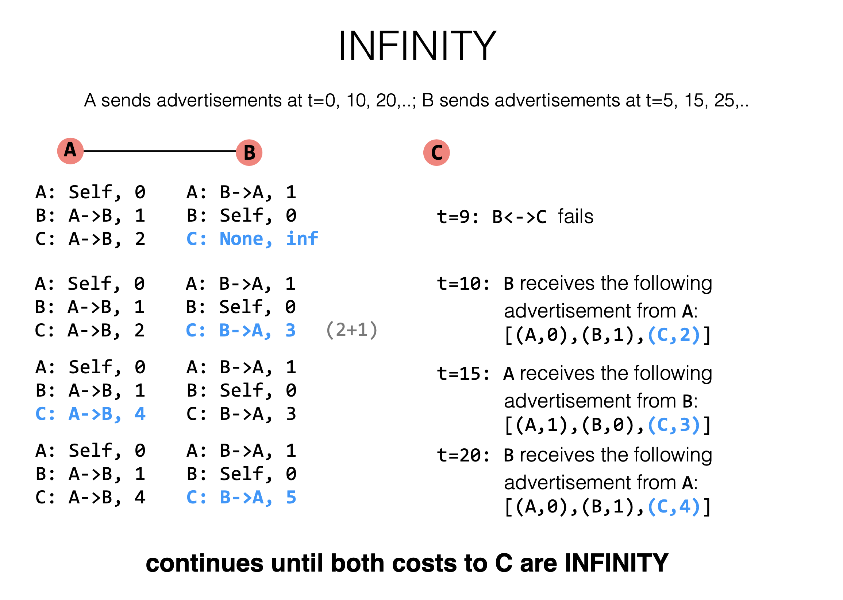

A: Self, 0
B: A->B, 1
C: A->B, 2
A: B->A, 1
B: Self, 0
C: B->C, 1

Slide 60
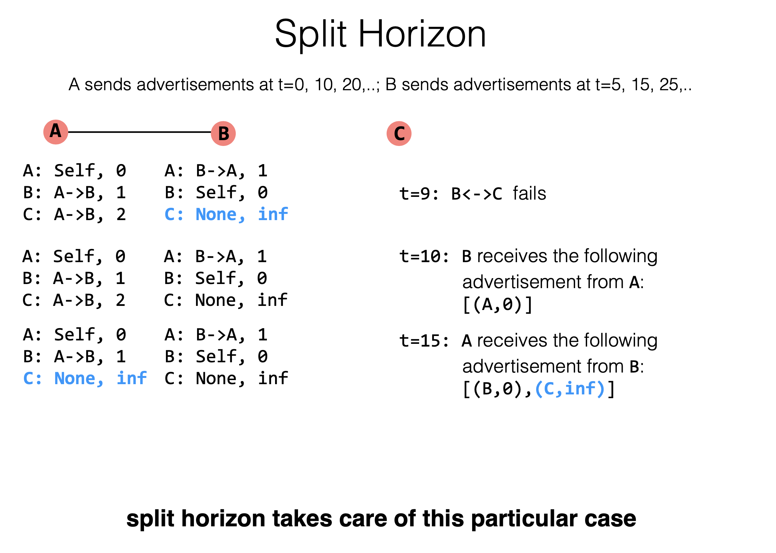
Notes:
从一端收到的路由信息，不能再从原路被发送回去。

Slide 61
Link-State Summary
Pros:
Fast convergence
Cons:
flooding is costly: 2 x #Node x #Line advertisements
Only good for small networks

Slide 62
Distance Vector
Pros:
Low overhead: 2x #Line advertisements
Cons:
Convergence time is proportional to longest path
The infinity problem
Only good for small networks

Slide 63
How to Scale the Routing?

Slide 64
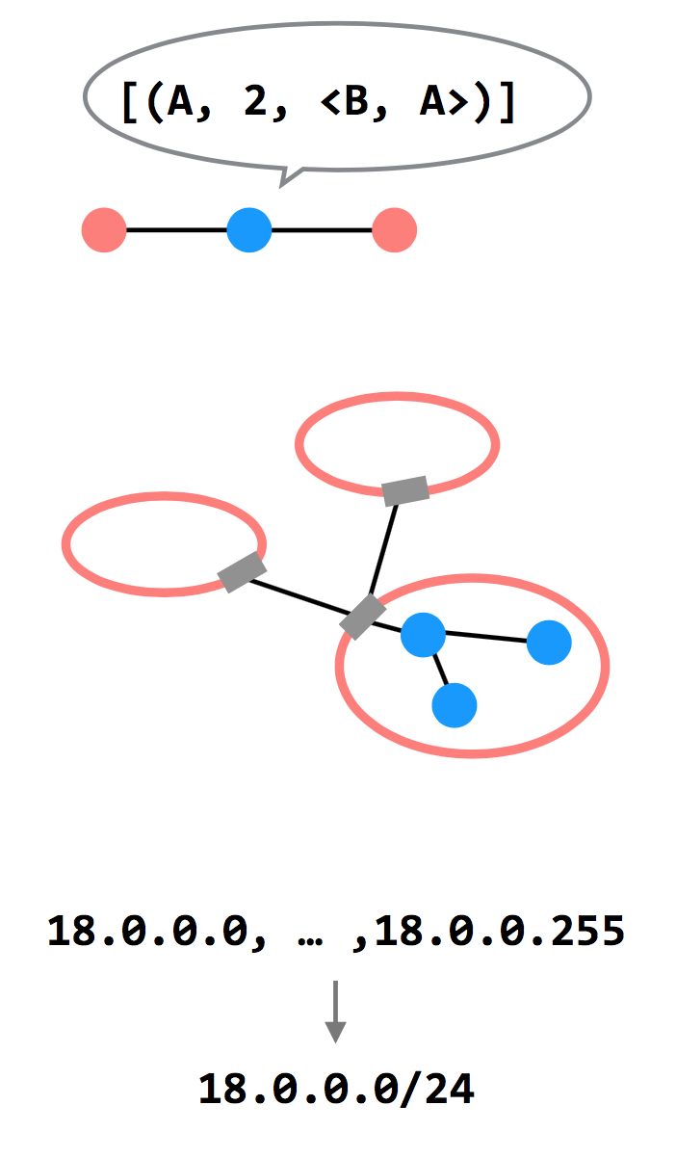
3 Ways to Scale
Path-vector Routing
Advertisements include the path, to better detect routing loops
Hierarchy of Routing
Route between regions, and then within a region
Topological Addressing
Assign addresses in contiguous blocks to make advertisements smaller

Slide 65
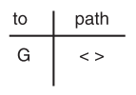
Path Vector Exchange
Each participant maintains a path vector
A complete path to some destination
E.g., zero-length path to itself
Gradually learns about other paths
Construct a new forwarding table from its new path vector
Algorithm
Advertising
Path selection

Slide 66
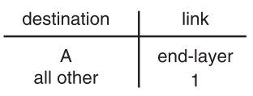
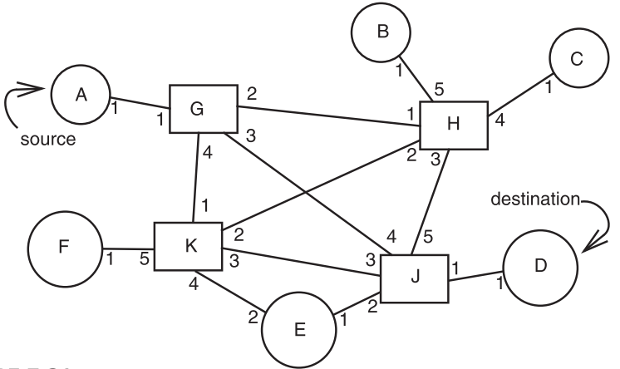
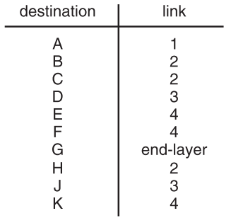
Path Vector Exchange
A
G
Need coordination to ensure no loop

Slide 67
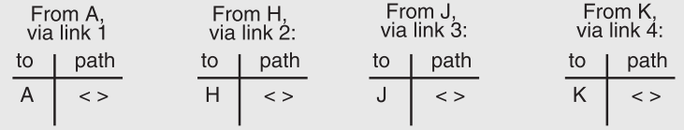
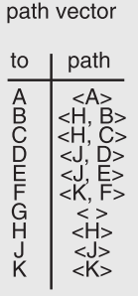
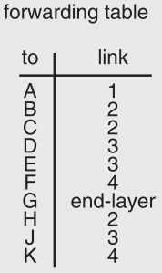
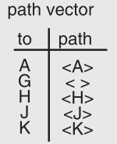
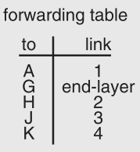
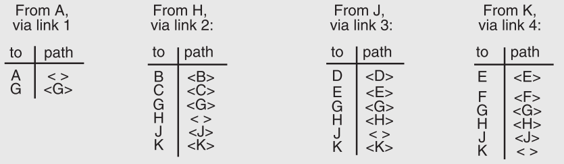

Slide 68
Path Vector Exchange
Better for scaling
Like Distance-Vector, but include the full path in the routing advertisements
Overhead increases (advertises are larger), but convergence time decreases (avoid counting to infinity)
Overhead is still lower than Link-State

Slide 69
Questions on Path Vector
How do we avoid permanent loops?
When a node updates its paths, it never accepts a path that has itself
What happens when a node hears multiple paths to the same destination?
It picks the better path
What happens if the graph changes?
Algorithm deals well with new links
To deal with links that go down, each router should discard any path that a neighbor stops advertising

Slide 70
Hierarchical Address Assignment & Routing
Two problems of the path vector implementation
Every attachment point must have a unique address
The path vector grows in size with the number of attachment points
Hierarchy for better scalability
Two parts of network address: region & station, e.g., "11,75"
Regions correspond to the set of closely-connected entities
E.g., region-11 has only 1 entry in other region routers' table

Slide 71
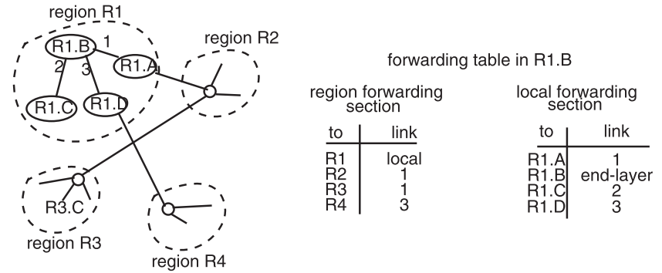
Hierarchical Address Assignment & Routing
Region is also as known as AS: Autonomous System

Slide 72
Hierarchical Address Assignment & Routing
Problems introduced by hierarchy: more complex
Binding address with location
Has to change address after changing location
Paths may no longer be the shortest possible
Algorithm has less detailed information
More about hierarchy
Can extend to more levels
Different places can have different levels

Slide 73
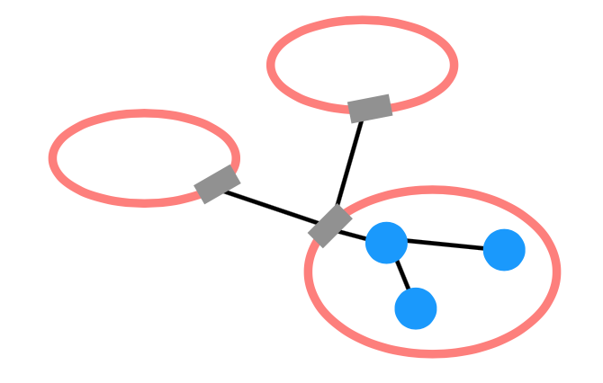
Routing Hierarchy
Across Region
Use one routing protocol to route across regions, and a different protocol to route within regions
Implies that there are devices on the edge of each region that can "translate" between or "speak" both protocols
BGP is the path-vector protocol used across regions
Border Gateway Protocol

Slide 74
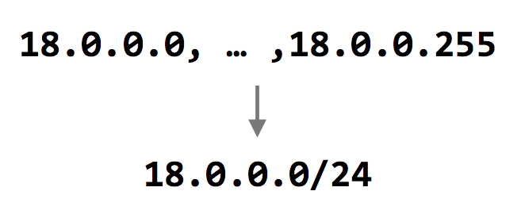
Topological Addressing
Further reduce the routing table
Despite being between regions, BGP still routes to IP addresses (e.g., to 18.0.0.1, not to region-3 )
Addresses are given to regions in contiguous blocks, so that they can be specified succinctly via a particular notation ("CIDR" notation)
CIDR: Classless Inter Domain Routing
Keeps advertisements small
CIDR Notation

Slide 75
Data Plane: Packet Forwarding

Slide 76
Network Layer Interface
structure packet
bit_string source
bit_string destination
bit_string end_protocol
bit_string payload

Slide 77
1 procedure NETWORK_SEND (segment_buffer, destination,
2 net_protocol, end_protocol)
3 packet instance outgoing_packet
4 outgoing_packet.payload ← segment_buffer
5 outgoing_packet.end_protocol ← end_protocol
6 outgoing_packet.source ← MY_NETWORK_ADDRESS
7 outgoing_packet.destination ← destination
8 NETWORK_HANDLE (outgoing_packet, net_protocol)
9 procedure NETWORK_HANDLE (net_packet, net_protocol)
10 packet instance net_packet
11 if net_packet.destination != MY_NETWORK_ADDRESS then
12 next_hop ← LOOKUP (net_packet.destination, forwarding_table)
13 LINK_SEND (net_packet, next_hop, link_protocol, net_protocol)
14 else
15 GIVE_TO_END_LAYER (net_packet.payload,
16 net_packet.end_protocol, net_packet.source)

Slide 79
Forwarding an IP Packet
Lookup packet's destination in forwarding table
If known, find the corresponding outgoing link
If unknown, drop packet
Decrement TTL (Time To Live)
Drop packet if TTL is zero
Update header checksum
Forward packet to outgoing port
Transmit packet onto link

Slide 80
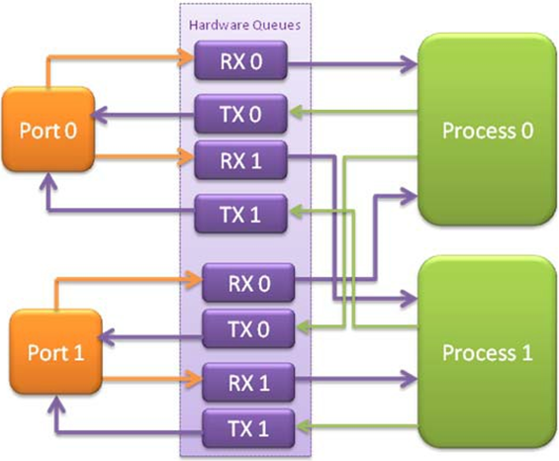
Data-plane Case Study: Intel's DPDK
DPDK: Data Plane Development Kit
Bypass kernel
Network card
Has several ports
A port has RX/TX
Processor
Read packets from RX
Polling
Find output port
Write packets to TX
RX for receiving
TX for sending

Slide 81
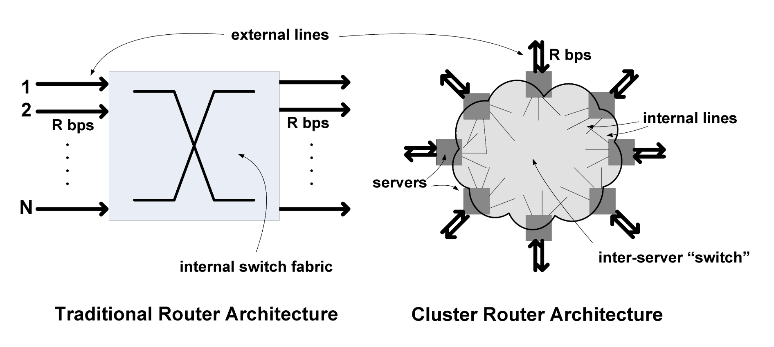
UC Berkeley’s RouteBricks [SOSP’09]

Slide 82
NAT
(Network Address Translation)

Slide 83
NAT (Network Address Translation)
Private network
Public routers do not accept routes to network 10 (e.g., 10.8.8.8)
NAT router: bridge the private networks
Router between private & public network
Send: modify source address to temp public address
Receive: modify back by looking mapping table
Limitations
Some end-to-end protocols place address in payloads
The translator may become the bottleneck
What if two private network merge?

Slide 84
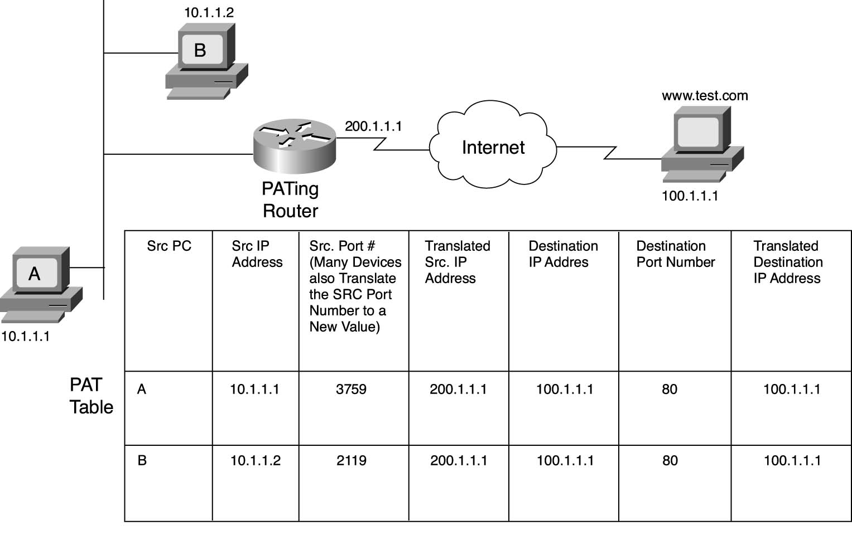
NAT

Slide 86
CASE: Ethernet Mapping
Mapping Internet to Ethernet

Slide 87
Case Study: Mapping Internet to Ethernet
Listen-before-sending rule, collision
Ethernet: CSMA/CD
Carrier Sense Multiple Access with Collision Detection
Ethernet type
Experimental Ethernet, 3 mpbs
Standard Ethernet, 10 mbps
Fast Ethernet, 100 mbps
Gigabit Ethernet, 1000 mbps

Slide 88
Overview of Ethernet
A half duplex Ethernet
The max propagation time is less than the 576 bit times, the shortest allowable packet
So that two parties can detect a collision together
If collision: wait random first time, exponential backoff if repeat
A full duplex & point-to-point Ethernet
No collisions & the max length of the link is determined by the physical medium

Slide 89
Difference between Hub and Switch
Hub
A frame is "broadcast" to every one of its ports
A 10/100Mbps hub must share its bandwidth with each port
Switch
Keeps a record of the MAC addresses of all the devices
A 10/100Mbps switch will allocate a full 10/100Mbps to each of its ports

Slide 90
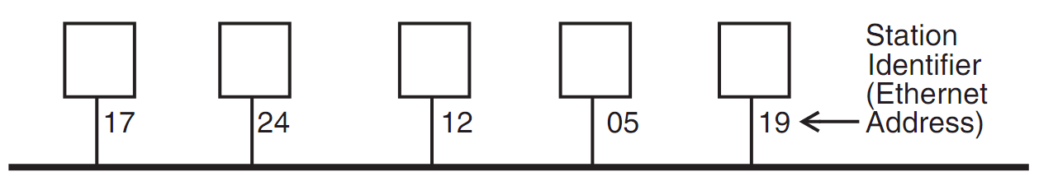
Broadcast Aspects of Ethernet
Broadcast network
Every frame is delivered to every station
(Compare with forwarding network)
ETHERNET_SEND
Pass the call along to the link layer
ETHERNET_HANDLE
Simple, can even be implemented in hardware

Slide 91
Broadcast Aspects of Ethernet
procedure ETHERNET_HANDLE (net_packet, length)
destination ← net_packet.target_id
if destination = my_station_id
then
GIVE_TO_END_LAYER (net_packet.data,
net_packet.end_protocol,
net_packet.source_id)
else
ignore packet
no need to do any forwarding

Slide 92
Broadcast Aspects of Ethernet
procedure ETHERNET_HANDLE (net_packet, length)
destination ← net_packet.target_id
if destination = my_station_id
or destination = BROADCAST_ID
then
GIVE_TO_END_LAYER (net_packet.data,
net_packet.end_protocol,
net_packet.source_id)
else
ignore packet

Slide 93
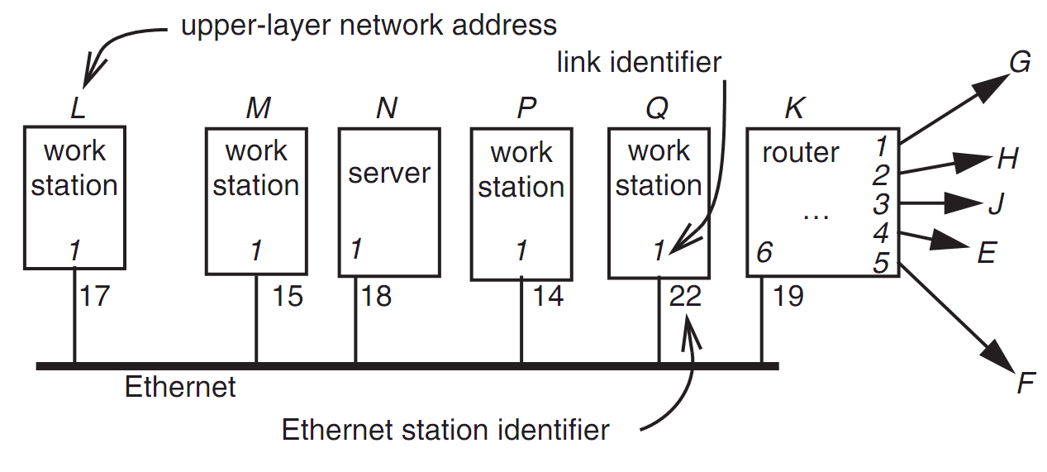
Layer Mapping: Attach Ethernet to Forwarding Network
15
L sends a RPC to N by sending to station 18 of link 1
L sends a RPC to E by sending to K, E may have 15 as address, as well as M

Slide 94
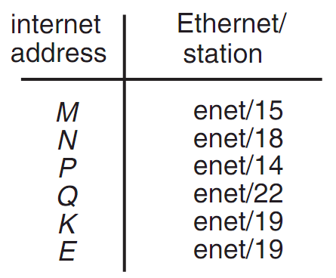
Layer Mapping
The Internet network layer
NETWORK_SEND (data, length, RPC, INTERNET, N)
NETWORK_SEND (data, length, RPC, ENET, 18)
L must maintain a table

Slide 95
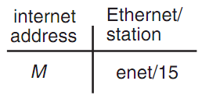
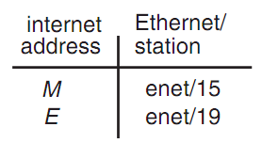
ARP (Address Resolution Protocol)
NETWORK_SEND ("where is M?", 11, ARP, ENET, BROADCAST)
NETWORK_SEND ("M is at station 15", 18, ARP, ENET, BROADCAST)
L asks E's Ethernet address, E does not hear the Ethernet broadcast, but the router at station 19 does, and it sends a suitable ARP response instead
Manage forwarding table as a cache

Slide 96
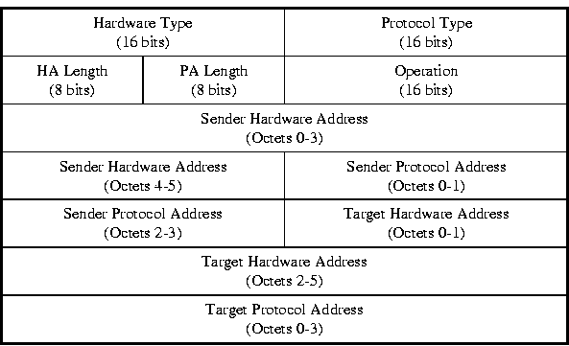
ARP & RARP Protocol
Name mapping: IP address <-> MAC address

Slide 97
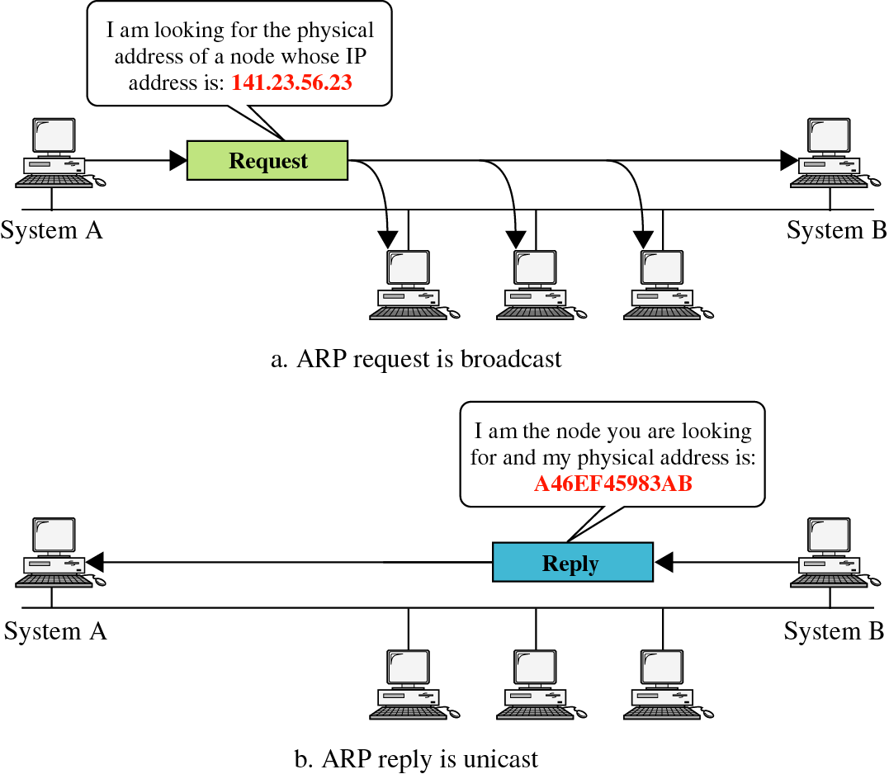
ARP & RARP

Slide 98
Network Topology
Take SJTU network for example
Subnet: usually like 192.168.0.2 or 10.0.0.2
Gateway: usually like 192.168.0.1
Get the global IP address: 202.120.40.82
A gateway usually has two (or more) IP address
Proxy: get proxy's address
E.g., 106.185.46.164 (Japan)

Slide 99
Network Topology

Slide 100
How to Use socket to Access www.baidu.com ?
You code as if your PC connect directly with Baidu
Call connect() with Baidu's IP address
But how does the system find next hop?

Slide 101
Putting All Together
App: I want to send a packet to Baidu, here is the packet with Baidu's IP in its header as target IP, and client's IP as source IP (Node-C)
OS: I don't know how to get to Baidu, I'll just send it to the router (gateway). But I cannot change the source IP of the packet, so I'll just change the MAC target address of the packet to the router's MAC address

Slide 102
Putting All Together
The router-1 (gateway): I get a packet with my MAC as target address. Is it my IP? No… So I'll just forward it to next hop, by changing the target MAC address to next hop's MAC address (NAT: change source IP and source port as well)
Router-2: I connect directly to Baidu, I'll just change the target MAC address to Baidu

Slide 103
ARP Spoofing
Construct spoofed ARP replies
A target computer could be convinced to send frames destined for computer A to instead go to computer B
Computer A will have no idea that this redirection took place
This process of updating a target computer's ARP cache is referred to as "ARP poisoning"

Slide 104
Spoofed ARP reply
IP:10.0.0.2
MAC:cc:cc:cc:cc
Spoofed ARP reply
IP:10.0.0.2
MAC:cc:cc:cc:cc
switch
Spoofed ARP reply
IP:10.0.0.2
MAC:cc:cc:cc:cc
A
IP:10.0.0.1
MAC:aa:aa:aa:aa
B
IP:10.0.0.2
MAC:bb:bb:bb:bb
Hacker
IP:10.0.0.3
MAC:cc:cc:cc:cc
ARP cache
ARP cache
IP | MAC
10.0.0.2 | bb:bb:bb:bb
IP | MAC
10.0.0.1 | aa:aa:aa:aa

Slide 105
switch
A
IP:10.0.0.1
MAC:aa:aa:aa:aa
B
IP:10.0.0.2
MAC:bb:bb:bb:bb
Hacker
IP:10.0.0.3
MAC:cc:cc:cc:cc
A's cache is poisoned
ARP cache
ARP cache
IP | MAC
10.0.0.2 | cc:cc:cc:cc
IP | MAC
10.0.0.1 | aa:aa:aa:aa

Slide 106
ARP Spoofing
Now all the packets that A intends to send to B will go to the hacker's machine
Cache entry would expire, so it needs to be updated by sending the ARP reply again
How often?
depends on the particular system
Usually every 40s should be sufficient
In addition the hacker may not want his Ethernet driver talk too much
Accomplish with ifconfig -arp

Slide 107
Man-in-the-Middle Attack
A hacker inserts his computer between the communications path of two target computers
The hacker will forward frames between the two target computers so communications are not interrupted
E.g., Hunt, Ettercap, etc.
Can be obtained easily in many web archives

Slide 108
Man-in-the-Middle Attack
The attack is performed as follows:
Suppose X is the hacker's computer
T1 and T2 are the targets
X poisons the ARP cache of T1 and T2
T1 associates T2's IP with X's MAC
T2 associates T1's IP with X's MAC
All of T1 and T2's traffic will then go to X first, instead of directly to each other

Slide 109
Spoofed ARP reply
IP:10.0.0.2
MAC:cc:cc:cc:cc
Spoofed ARP reply
IP:10.0.0.2
MAC:cc:cc:cc:cc
switch
Spoofed ARP reply
IP:10.0.0.2
MAC:cc:cc:cc:cc
T1
IP:10.0.0.1
MAC:aa:aa:aa:aa
T2
IP:10.0.0.2
MAC:bb:bb:bb:bb
Hacker
IP:10.0.0.3
MAC:cc:cc:cc:cc
ARP cache
ARP cache
IP | MAC
10.0.0.2 | bb:bb:bb:bb
IP | MAC
10.0.0.1 | aa:aa:aa:aa

Slide 110
switch
T1
IP:10.0.0.1
MAC:aa:aa:aa:aa
T2
IP:10.0.0.2
MAC:bb:bb:bb:bb
Hacker
IP:10.0.0.3
MAC:cc:cc:cc:cc
ARP cache
ARP cache
IP | MAC
10.0.0.2 | cc:cc:cc:cc
IP | MAC
10.0.0.1 | aa:aa:aa:aa
T1's cache is poisoned

Slide 111
Forged ARP replies
IP:10.0.0.1
MAC:cc:cc:cc:cc
switch
Forged ARP replies
IP:10.0.0.1
MAC:cc:cc:cc:cc
T1
IP:10.0.0.1
MAC:aa:aa:aa:aa
T2
IP:10.0.0.2
MAC:bb:bb:bb:bb
Hacker
IP:10.0.0.3
MAC:cc:cc:cc:cc
ARP cache
ARP cache
IP | MAC
10.0.0.2 | cc:cc:cc:cc
IP | MAC
10.0.0.1 | aa:aa:aa:aa

Slide 112
switch
T1
IP:10.0.0.1
MAC:aa:aa:aa:aa
T2
IP:10.0.0.2
MAC:bb:bb:bb:bb
Hacker
IP:10.0.0.3
MAC:cc:cc:cc:cc
ARP cache
ARP cache
IP | MAC
10.0.0.2 | cc:cc:cc:cc
IP | MAC
10.0.0.1 | cc:cc:cc:cc
T2's cache is poisoned

Slide 113
Message intended to send to T2
switch
Hacker will
relay the
message
T1
IP:10.0.0.1
MAC:aa:aa:aa:aa
T2
IP:10.0.0.2
MAC:bb:bb:bb:bb
Hacker
IP:10.0.0.3
MAC:cc:cc:cc:cc
ARP cache
ARP cache
IP | MAC
10.0.0.2 | cc:cc:cc:cc
IP | MAC
10.0.0.1 | cc:cc:cc:cc

Slide 114
Hacker will relay the message
switch
Message
intended to
send to T1
T1
IP:10.0.0.1
MAC:aa:aa:aa:aa
T2
IP:10.0.0.2
MAC:bb:bb:bb:bb
Hacker
IP:10.0.0.3
MAC:cc:cc:cc:cc
ARP cache
ARP cache
IP | MAC
10.0.0.2 | cc:cc:cc:cc
IP | MAC
10.0.0.1 | cc:cc:cc:cc

Slide 115
Defenses against ARP Spoofing
No Universal defense (!)
Use static ARP entries
Cannot be updated; Spoofed ARP replies are ignored
ARP table needs a static entry for each machine on the network
Large overhead
Deploying these tables; Keep the table up-to-date
Arpwatch
A free UNIX program which listens for ARP replies on a network
Build a table of IP/MAC associations and store it in a file
When a MAC/IP pair changes (flip-flop), an email is sent to an administrator

